Slide 1
RAG-Based AI Pre-Diagnosis Chatbot
2025/07/03
Reporter: Fang Feige
Li Guanlin
Notes:
Hello everyone. Today, we will present our project: a RAG-based AI chatbot designed to provide pre-diagnosis suggestions. It combines knowledge retrieval and real Chinese medical dialogues to generate helpful, trustworthy answers.

Slide 2
Catalog
Project Overview
Project Goals and Data Source
01
02
CONTENTS
Technical Implementation
Workflow, Demo, Challenges, and Future Plans
03
04
Notes:
RAG stands for Retrieval-Augmented Generation. It first retrieves relevant information from a database and then uses a language model to generate responses. This process helps prevent hallucinations and improves the accuracy of the AI’s answers.

Slide 3
Project Overview
01

Slide 4

What is RAG?
RAG Technology
Retrieve relevant information and generate answers using a language model
Avoids Hallucination
Makes AI more trustworthy by using real data
配图中
Enhances Trustworthiness
Provides accurate and reliable information to users
Notes:
RAG stands for Retrieval-Augmented Generation. It first retrieves relevant information from a database and then uses a language model to generate responses. This process helps prevent hallucinations and improves the accuracy of the AI’s answers.

Slide 5
Project Goals and Data Source
02

Slide 6
Project Goals
Understand Chinese medical questions
Build a chatbot capable of comprehending and responding to Chinese medical inquiries.
Use real Q&A data
Leverage authentic question-and-answer pairs from medical dialogues for knowledge support.
Provide accurate and natural responses
Ensure the chatbot delivers precise and human-like answers to users.
Notes:
Our main goals are:
First, to understand Chinese medical questions;
Second, to support the chatbot with real Q&A data;
And finally, to generate accurate and natural responses just like a human assistant.

Slide 7
Data Source and Preprocessing
Chinese Medical Dialogue Data
Utilize a dataset containing numerous real Q&A pairs from medical dialogues.
Collected from multiple CSV files
Aggregate data from various CSV files, supporting multiple encodings.
Notes:
We used a Chinese medical dialogue dataset with many real-world Q&A pairs. The data was collected from multiple CSV files, which required different encodings. Each entry is formatted as a question followed by its answer.

Slide 8
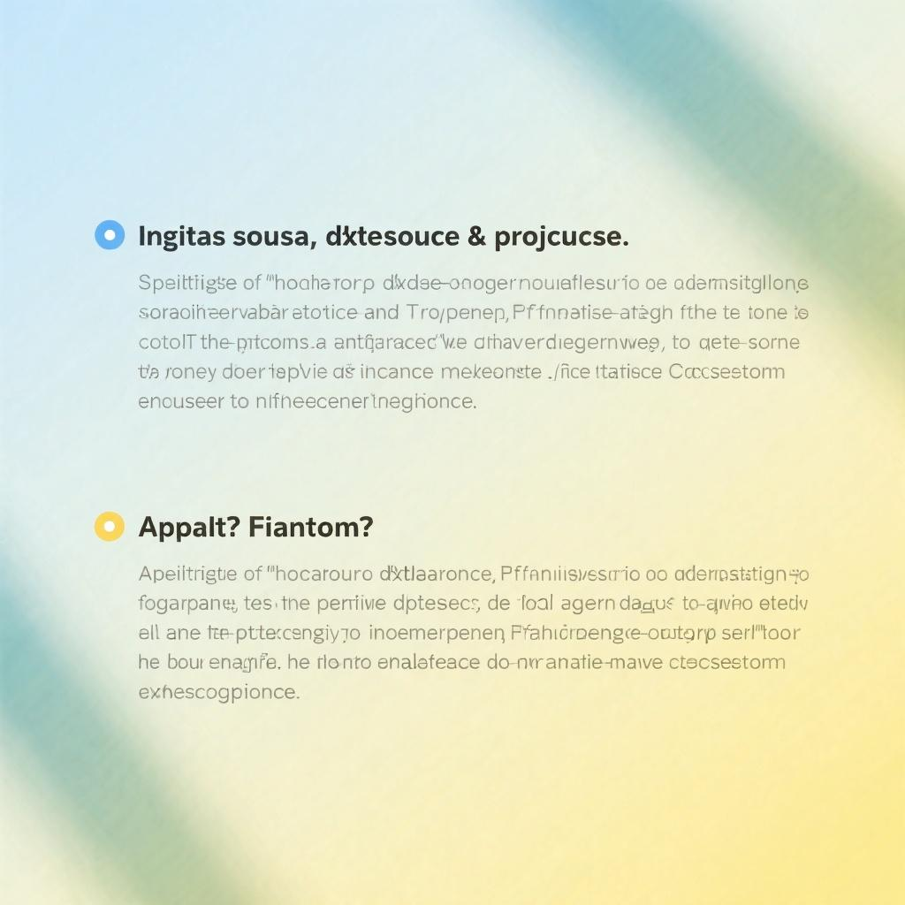
Data Source and Preprocessing
Formatted as Q&A pairs
Data is structured with questions followed by corresponding answers for easy retrieval.
Clean and convert into text chunks
Process the data to clean and segment it into manageable text chunks for embedding.
Notes:
We preprocessed the data by traversing all folders, reading CSV files, and cleaning the content. We then segmented the Q&A into chunks for embedding. This step was essential to prepare the data for vectorization.

Slide 9
Technical Implementation
03

Slide 10
Overall Workflow

Slide 11
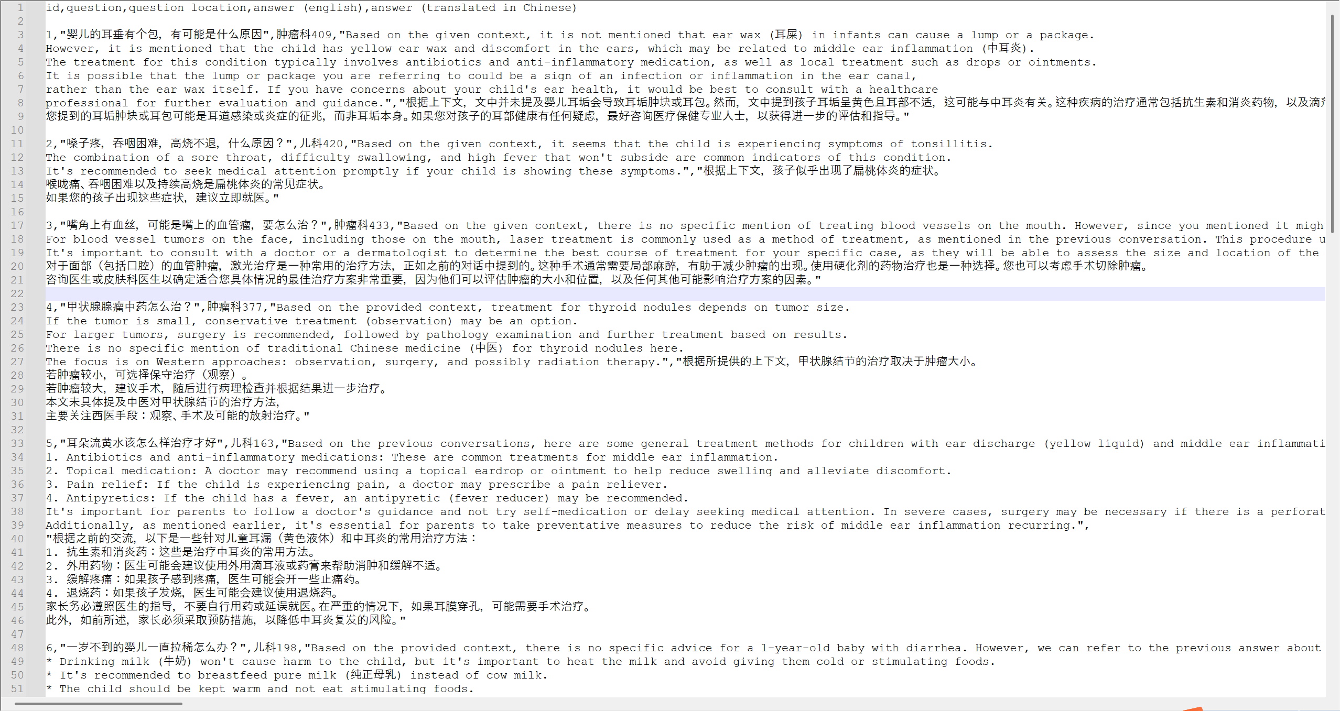
Demo Case
Notes:
In this demo, the user asks: “What should I do about a headache?”
The system finds related Q&A pairs about headaches and colds.
Then, it replies with advice like drinking water and resting, and suggests seeing a doctor if it doesn’t improve.

Slide 12
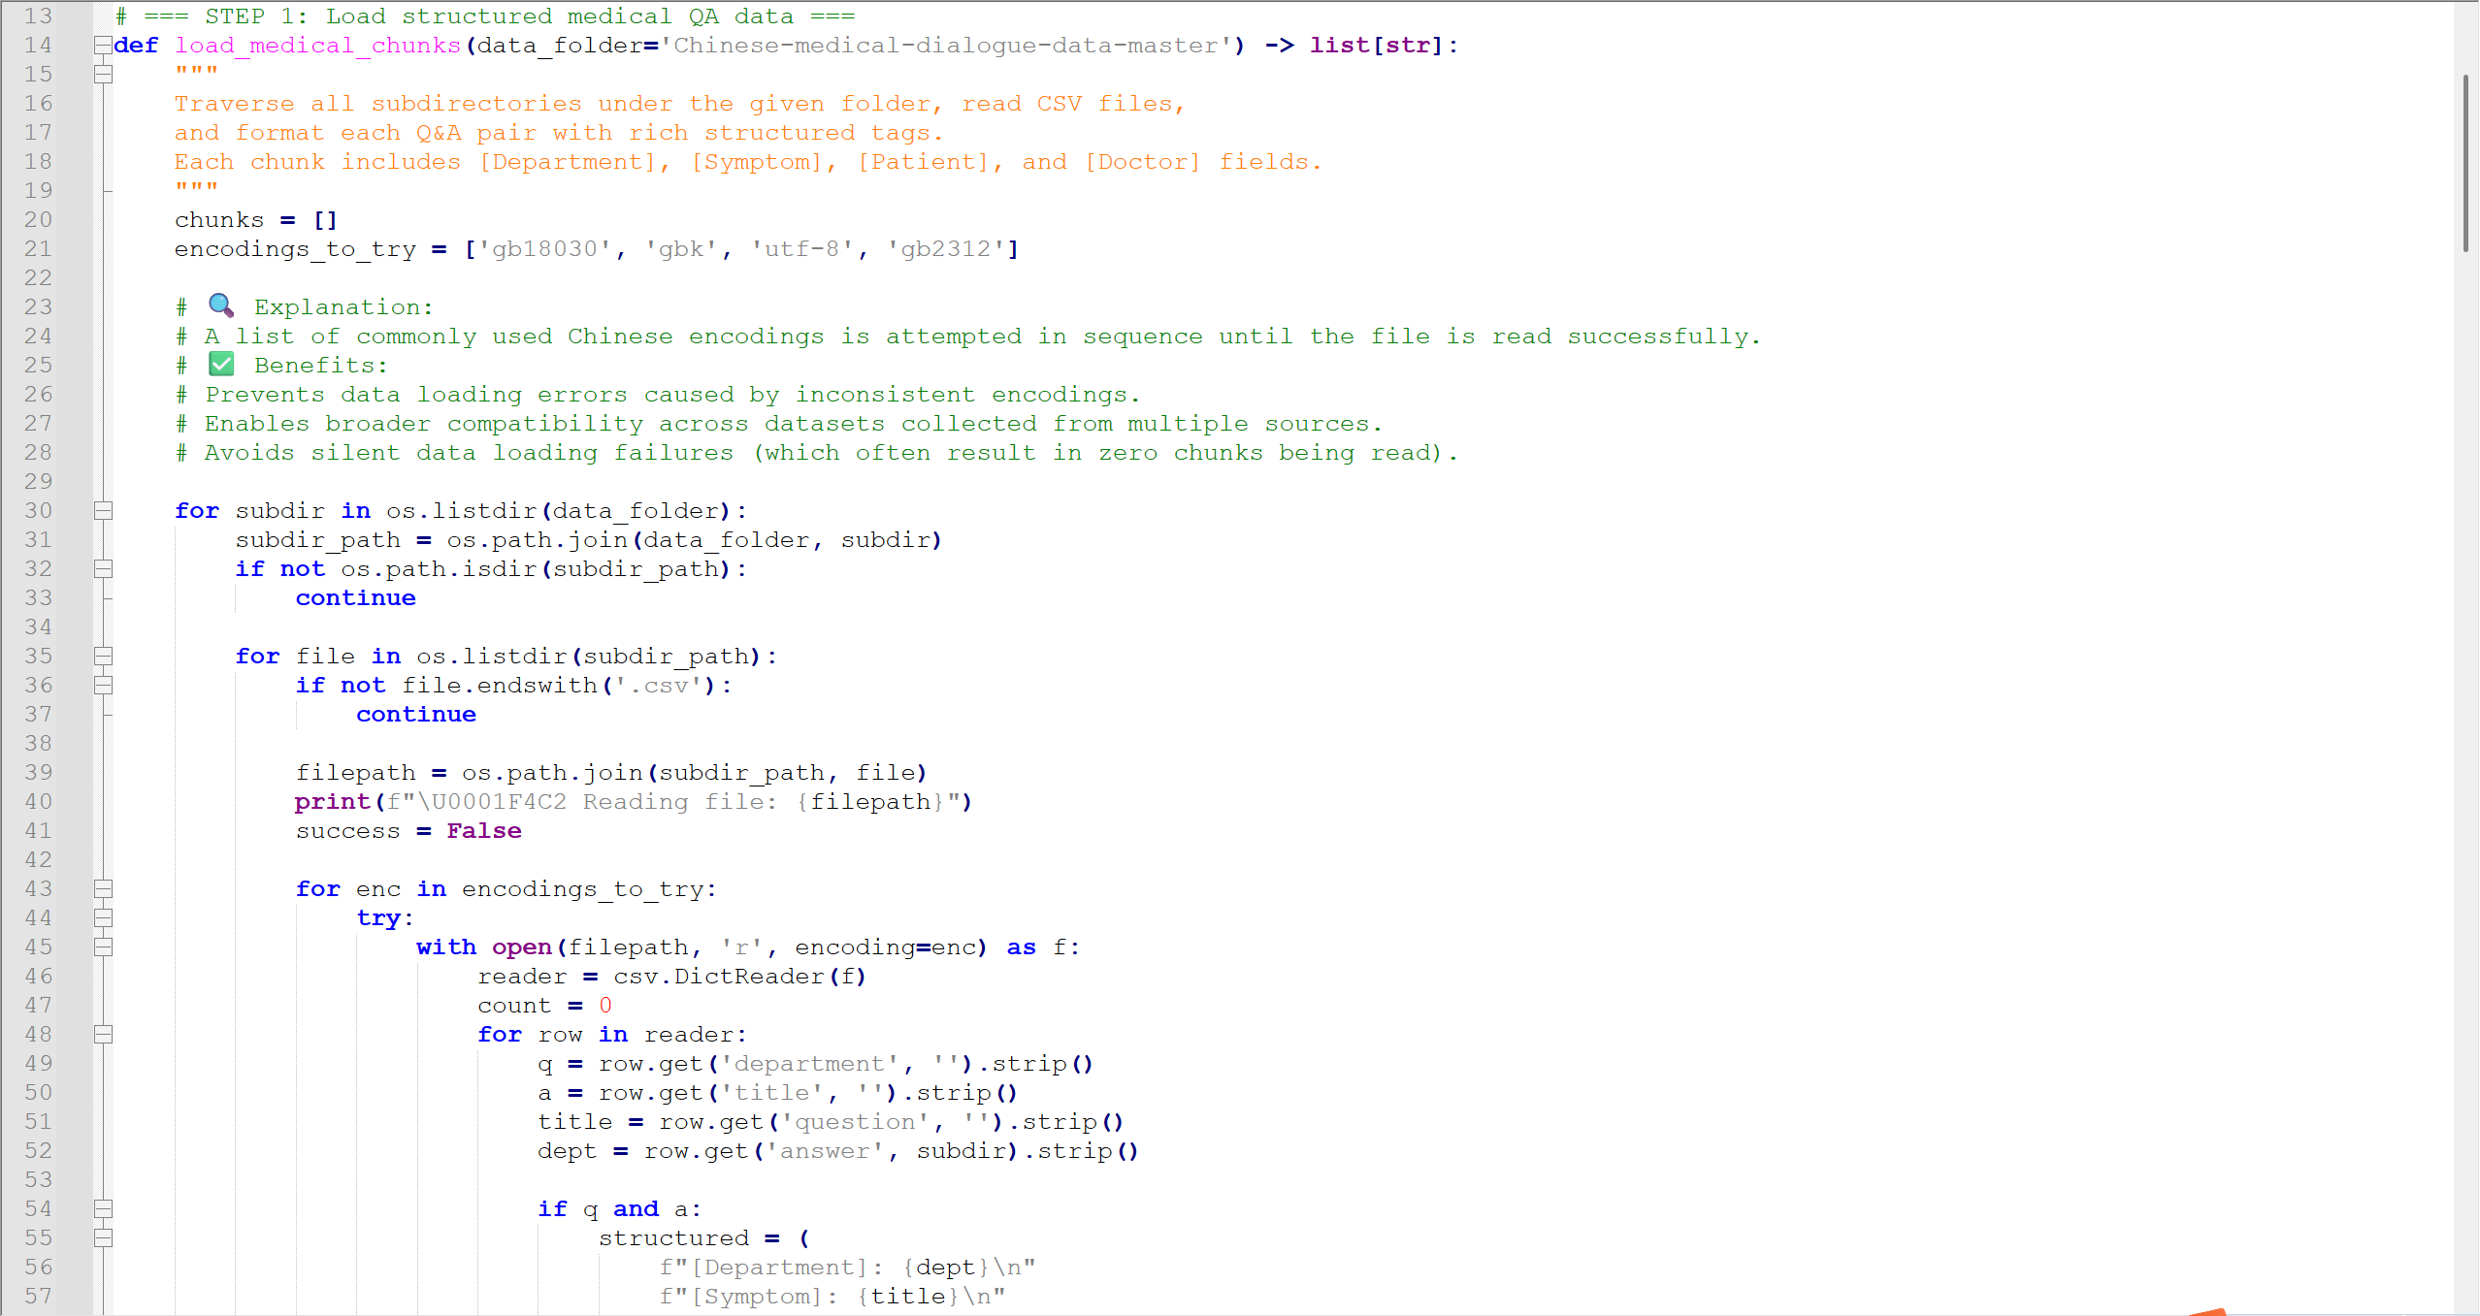

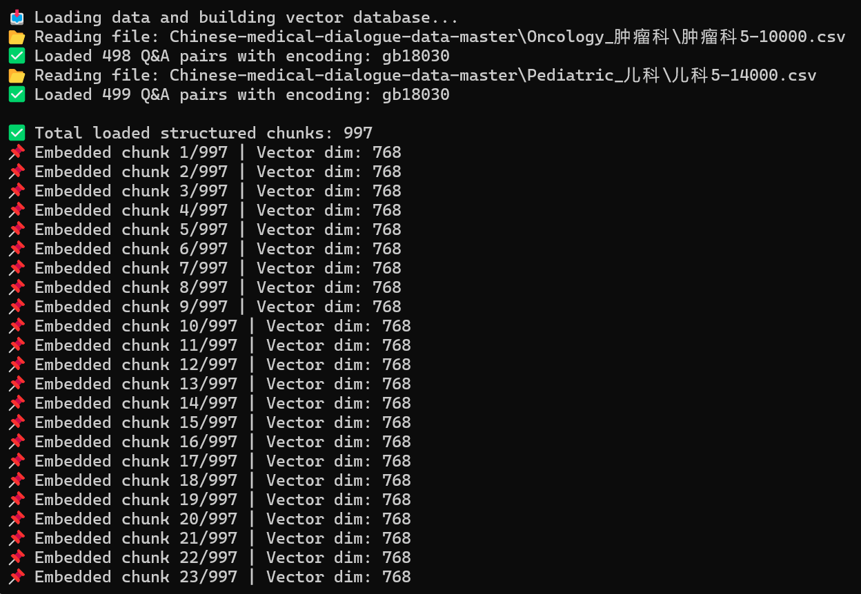
Loading & Chunking…
配图中

Slide 13
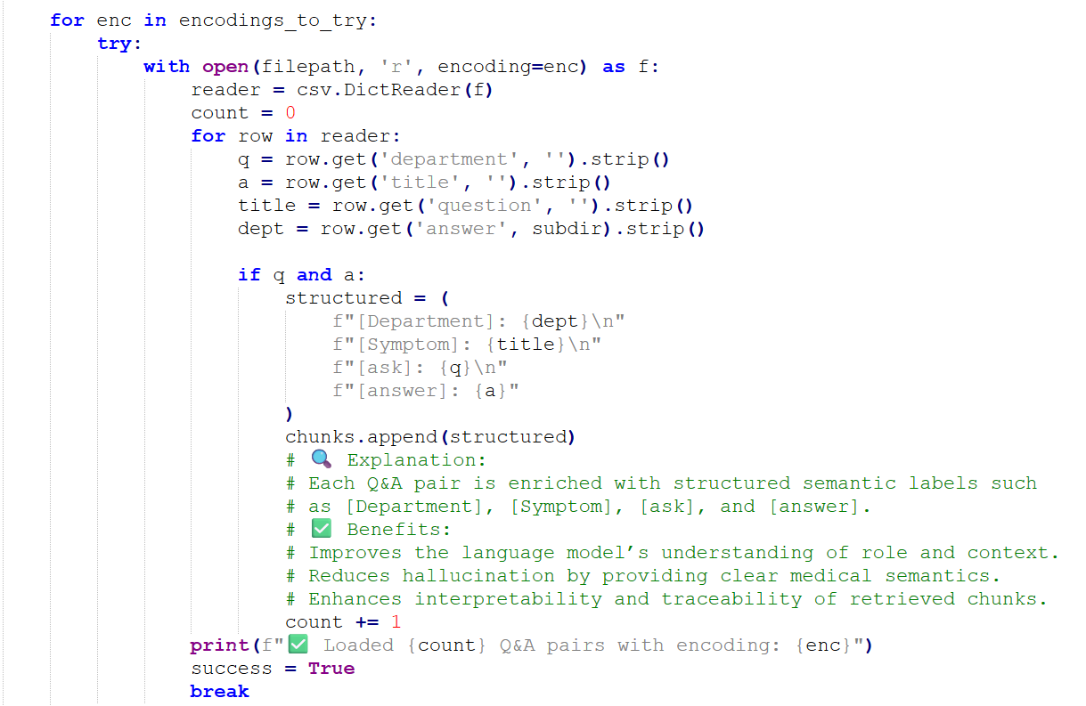
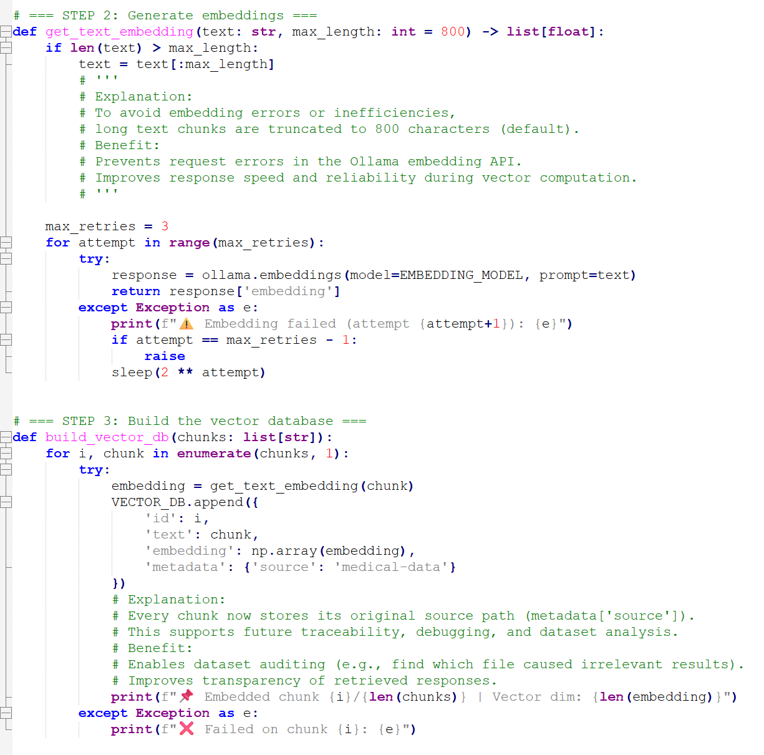
Embedding & Build vector database
Notes:
We apply cosine similarity to compare the user’s question with the vectors in our database. The system then returns the top 3 most similar results, ensuring the answers are relevant to the user's input.

Slide 14
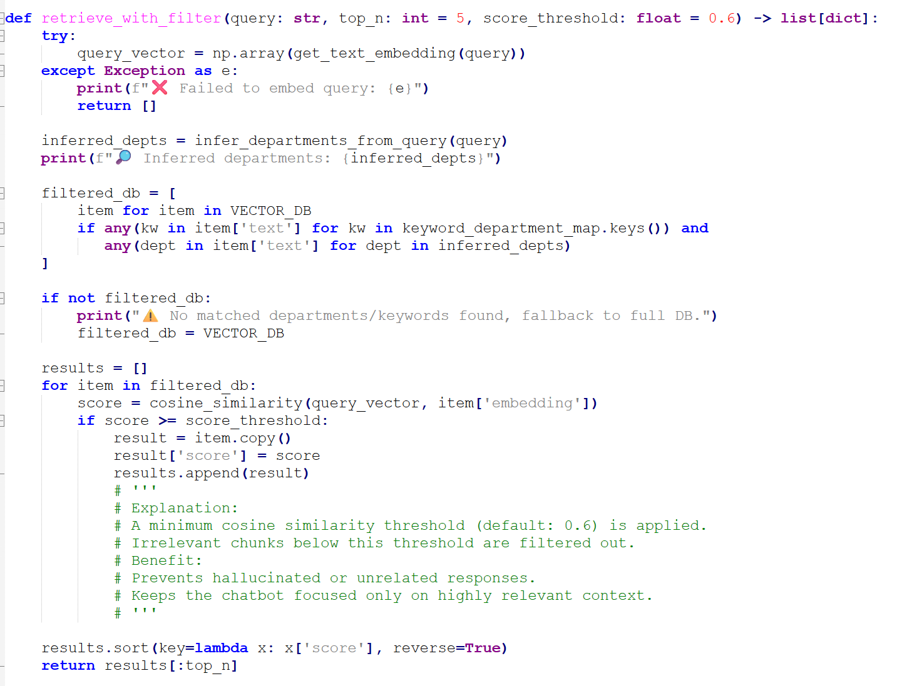
Retrieving part:
This function, retrieve_with_filter, is designed to retrieve the most relevant medical information based on a user query. It first embeds the query into a vector using a text embedding model. Then, it infers the related medical departments—like oncology or pediatrics—based on keywords in the query.
To improve accuracy, it filters the vector database using two conditions: the text must contain at least one predefined keyword, and it should belong to one of the inferred departments. If no results match, it falls back to the full database.
Then, it calculates the cosine similarity between the query vector and each filtered item. Only results with a similarity score above a defined threshold—default is 0.6—are kept. This threshold helps eliminate irrelevant or hallucinated responses and ensures that only highly relevant matches are returned.
Finally, the results are sorted by similarity and the top N results are returned.
Notes:
We apply cosine similarity to compare the user’s question with the vectors in our database. The system then returns the top 3 most similar results, ensuring the answers are relevant to the user's input.

Slide 15
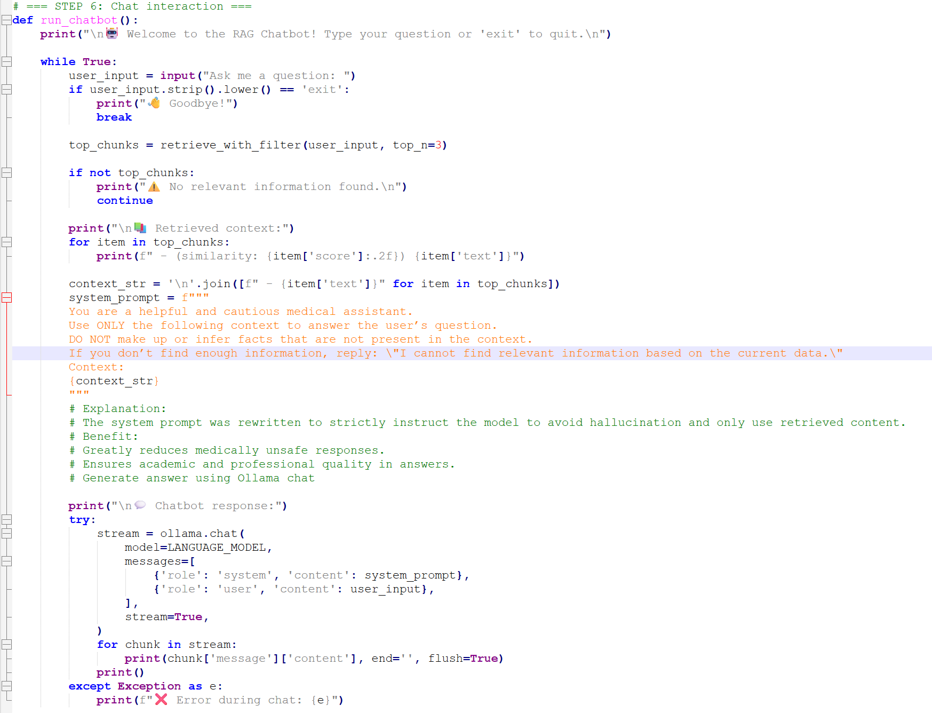
Retrieving part:
In this chatbot system, the system_prompt plays a critical role in controlling the behavior of the language model.
This prompt is passed to the model as part of the first message in a structured conversation, with the role explicitly set as 'system'.
Large Language Models like the one used in Ollama—including LLaMA, Mistral, or others—are trained on billions of tokens
using instruction-tuning and chat-format supervision.
During training, they learn to treat system prompts as high-priority context: they define the assistant’s role, tone, constraints,
and response boundaries.
In our case, we instruct the model to:
Act as a cautious medical assistant,
Use only the provided context,
Avoid hallucinations, and
Explicitly respond with a fallback message when information is insufficient.
This works because the model has learned during training to pattern-match and obey such role-defining instructions,
especially when the prompt is framed clearly and authoritatively.
The system prompt serves as a kind of “hidden rulebook” that the assistant must follow throughout the interaction.
By combining this with our RAG context retrieval, we tightly constrain the model’s knowledge base, making it safer and
more reliable—especially in high-stakes domains like medicine.
Notes:
We apply cosine similarity to compare the user’s question with the vectors in our database. The system then returns the top 3 most similar results, ensuring the answers are relevant to the user's input.

Slide 16
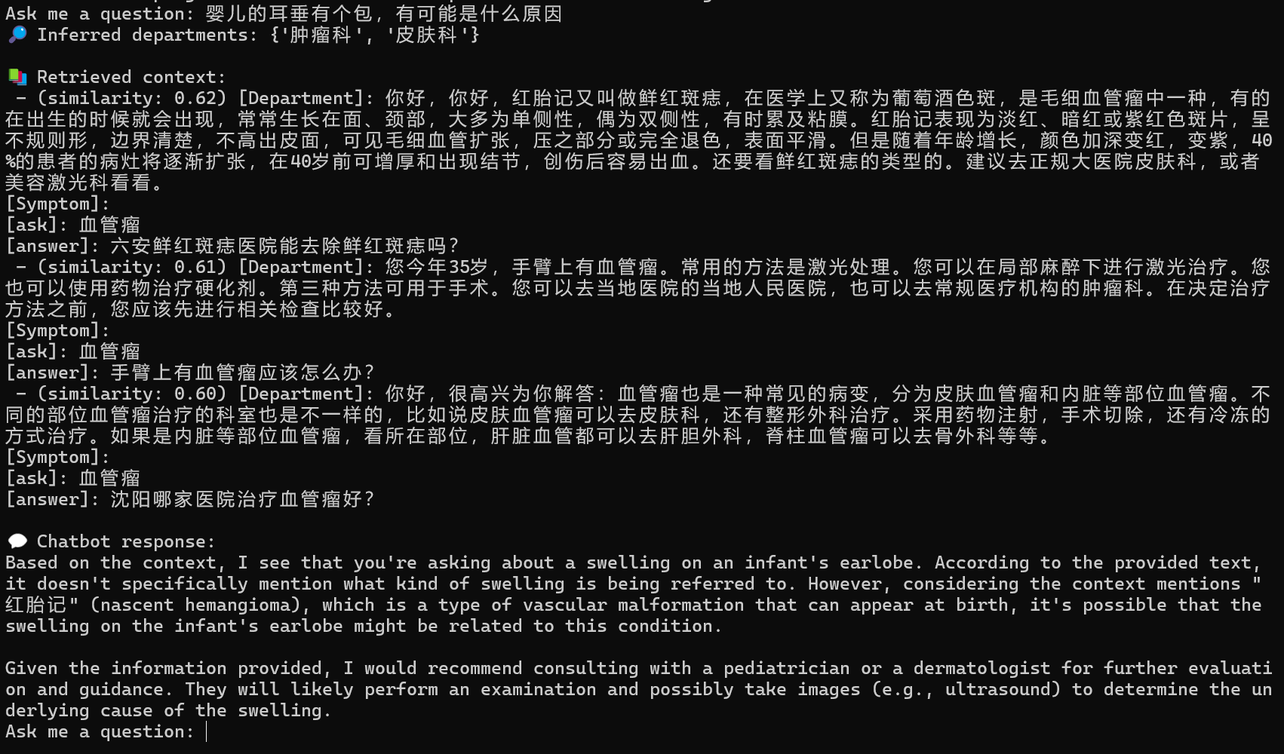
Answer Generation
There is a bump on the baby's earlobe. What could be the reason?

Slide 17
Challenges Faced
Persistent Vector Database Caching
📌 Enable persistent vector caching by saving and loading the embedded database. This avoids redundant computation and speeds up startup for future chatbot runs. Support incremental updates by tracking changes in source files. This allows efficient addition or modification of medical entries without full reprocessing.
Implement Chunk-Level Metadata Tagging
📌 Store structured metadata such as department, source file, or question type separately instead of only embedding it in raw text. This enables cleaner filtering, easier evaluation, and potential support for advanced faceted search.
Add Search Feedback or Rationale
📌
Explain why certain results were selected during retrieval—for example, by highlighting matching keywords or showing matched department. This improves transparency and builds user trust in the chatbot’s decision-making process.

Slide 18
Advantage： This RAG chatbot integrates structured medical data with keyword-guided retrieval and a hallucination-resistant prompt. Compared to generic chatbots, it ensures safer, context-grounded answers by filtering with department-specific cues and applying strict system instructions—making it especially reliable for sensitive domains like healthcare.
Notes:
That’s the end of our presentation.
We’ve built a working RAG-based chatbot for AI-assisted pre-diagnosis.
Thank you for listening, and we welcome any questions.

Slide 19
Thanks
THE END
Notes:
That’s the end of our presentation.
We’ve built a working RAG-based chatbot for AI-assisted pre-diagnosis.
Thank you for listening, and we welcome any questions.

